Slide 1
Fundamental Principles of Counting

Slide 2
Contents
Rules of Sum and Product 합, 곱의 법칙
Permutations 순열
Combinations: Binomial Theorem 조합
Combinations with Repetition 중복 조합
Catalan Numbers

Slide 3
Rules of Sum and Product
Useful for analyzing complicated problems through decomposing into parts and combining partial solutions together
Rule of Sum
If a first task can be performed in m ways (1),
while a second task in n ways (2), and
the two tasks cannot be performed simultaneously (3),
then performing either task can be accomplished in any one of m + n ways.
Three math. textbooks in English
Two math. textbooks in Korean
How many ways ?

Slide 4
Rule of Product
If a procedure can be broken down into first and second stages (1),
and if there are m possible outcomes for the first stage (2) and
if, for each of these outcomes, there are n possible outcomes for the second stage (3),
then the total procedure can be carried out, in the designated order, in m × n ways.
A
B
C
How many ways for A → B → C ?

Slide 5
Permutations
Definition
Given a collection of n distinct objects, any (linear) arrangement of these objects is called a permutation of the collection.
In general, if there are n distinct objects and r is an integer, with 1 ≤ r ≤ n, then by the rule of product, the number of permutations of size r for the n objects is
…
1st
2nd
3rd
r-th

Slide 6
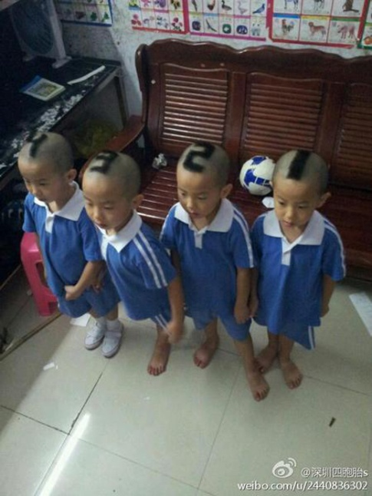
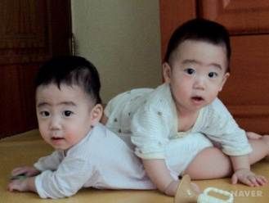
For n distinct objects, if repetitions are allowed, then by the rule of product there are n^{r} possible arrangements, with r ≥ 0.
If there are n objects with n₁ indistinguishable objects of a first type, n₂ of a second type, … , n_{r} of an r-th type, where n₁ + n₂ + … + n_{r} = n, then there are
(linear) arrangements of the given n objects.
5
5
5

Slide 7
( Examples )
1. How many paths from (2,1) to (7,4) in the xy-plane?
Each path consists of 5 moves to the right and 3 moves upward. Thus the number of paths is 8! / (5! 3!) = 56.
2. How many circular arrangements of six people at a round table ?
6! / 6 = 5! = 120
(The rotation factor should be removed.)
3. How many sexually alternate arrangements of three males and three females at a round table ?
3 × 2 × 2 × 1 × 1 = 12. (3!/3) × 3!
RRUURRUR
a
f
b
e
c
d
a
f
b
e
c
d

Slide 8
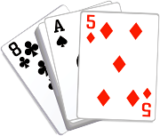
Combinations: Binomial Theorem
Combination: Unordered Selection
The number of combinations of size r from a collection of n distinct objects is
C(n, r) is sometimes read as “n choose r”.
Note that C(n, 0) = 1, for all n ≥ 0, and C(n, r) = C(n, n – r).

Slide 9
Binomial Theorem
If x and y are variables and n is a positive integer, then
Why is the coefficient a_{k} for the term x^{k} y^{n-k} equal to C(n,k) ?
The a_{k} is the number of different ways in which we can select k x’s (and consequently (n – k) y’s) from the n available (x + y) factors.
Thus a_{k} = C(n,k).
…
1
2
3
n-1
n

Slide 10
Corollary : For each integer n > 0,
?

Slide 11
Multinomial Theorem
For positive integers n, t, the multinomial coefficient of
in the expansion of is
where for all and .

Slide 12
:
x³y²
from (x + y)⁵
w⁴x²y³z²

Slide 13
Combinations with Repetition
An Example
On their way home from track practice, seven high school freshmen stop at a restaurant, where each of them has one of the following: a cheese-burger, a hot dog, a taco, or a fish sandwich. How many different purchases are possible?
Answer : The number of ways for selecting 7(r) of 4(n) different objects, with repetition, is C(n + r – 1, r) = C(4 + 7 – 1, 7) = C(10, 7).
c, c, c, h, h, t, f ➔ x x x | x x | x | x
c, c, h, h, h, t, f ➔ x x | x x x | x | x
t, t, t, t, t, t, f ➔ | | x x x x x x | x
10

Slide 14
When we wish to select, with repetition, r of n distinct objects, we find that we are considering all arrangements of r x’s and (n – 1) | ’s and the total number of ways is
(Question) What is the probability that all the students select the same food ?
Total different purchases : 10! / 7!3! = 120 (previously known)
All the same food purchases : n = 4, r = 1 → ₄H₁ = ₄C₁ = 4
Therefore, the probability is 1/30 (= 4/120).

